Slide 1
Sources
Material borrowed from peerinstruction4cs.org: http://www.peerinstruction4cs.org/2013/07/13/cs2-in-c-peer-instruction-materials/
Session ID: 861669 (channel 26)

Slide 2
Using a Stack to buffer file input
void mystery(ifstream& infile) {
Stack<string> lines;
string line;
while (getline(infile,line)) {
lines.push(line);
}
infile.close();
while (!lines.isEmpty()) {
cout << lines.pop()
<< endl;
}
}
What does this code do?
Prints all lines of a file to cout
Prints only the first line of a file to cout
Prints only the last line of a file to cout
Prints all lines of a file to cout in reverse
All/ none/ more than one of the above

Slide 3
Operator Precedence and Syntax Trees
Ignoring operator precedence rules, how many distinct results are there to the following arithmetic expression?
3 * 3 + 3 * 3
1
2
3
4
More than 4

Slide 4
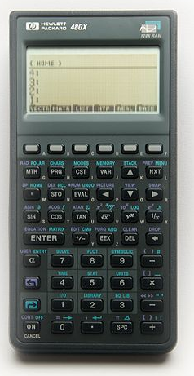
Reverse Polish Notation
Ambiguities don’t exist in RPN
Also called “postfix” because the operator goes after the operands
Postfix (RPN):
4 3 * 4 3 * +
Equivalent Infix:
(4*3) + (4*3)
http://commons.wikimedia.org/wiki/File:Hewlett-Packard_48GX_Scientific_Graphing_Calculator.jpg

Slide 5
Reverse Polish Notation
This postfix expression:
4 3 * 7 2 5 * + +
Is equivalent to this infix expression:
((4*3) + (7*2)) + 5
(4*3) + ((7+2) + 5)
(4*3) + (7 + (2*5))
Other/none/more than one
http://commons.wikimedia.org/wiki/File:Hewlett-Packard_48GX_Scientific_Graphing_Calculator.jpg

Slide 6
Stacks and RPN
Evaluate this expression with the help of a stack
Encounter a number: PUSH it
Encounter an operator: POP two numbers and PUSH result
4 3 * 7 2 5 * + +
Contents of the stack, reading from top down:
7, 12
2, 7, 12
10, 7,12
10, 5, 2, 7, 12
Other
*
*
+
+
4
4
3
12
12
7
12
7
2
12
7
2
5
12
7
10
12
17
29

